Slide 1
Virtualizer Studio: TLM Creation
Quickstart Training - Introduction
© 2024 Synopsys, Inc. All Rights Reserved
Notes:
Welcome to the QuickStart training of the TLM Creation perspective of Virtualizer Studio!

Slide 2
CONFIDENTIAL INFORMATION
The information contained in this presentation is the confidential and proprietary information of Synopsys. You are not permitted to disseminate or use any of
the information provided to you in this presentation outside of Synopsys without prior written authorization.
IMPORTANT NOTICE
In the event information in this presentation reflects Synopsys’ future plans, such plans are as of the date of this presentation and are subject to change. Synopsys is not obligated to update this presentation or develop the products with the features and functionality discussed in this presentation. Additionally, Synopsys’ services and products may only be offered and purchased pursuant to an authorized quote and purchase order or a mutually agreed upon written contract with Synopsys.

Slide 3
Agenda
Introduction
  Virtualizer Studio Overview + TLM Creation Flow
Part 1: Model Skeleton Creation
  Model interfaces, memories, registers, build settings, IP-XACT import, etc.
Part 2: Test Driven Design Methodology
  Unit testing framework, test utilities, functional coverage, etc.
Part 3: Model Behavior Implementation
  Default and custom callbacks, continuous assignments, etc.
Part 4: Model Debugging
  SystemC debugging, using FastTrack messages, source code debugging, etc.
Part 5: Import of Existing SystemC Models
Part 6: Model Integration in Virtual Prototype Design
Notes:
Look into the overview to get an insight into the training contents.

Slide 4

Target Audience
The training is for model developers who want to:
Create new TLM SystemC/SCML models for use in Synopsys Virtual Platform tools
Import or wrap existing TLM SystemC models for use in Synopsys Virtual Platform tools
Systematically test and debug TLM SystemC models

Slide 5

Objectives
After completing this module, you should be able to:
Use the features of Virtualizer Studio’s TLM Creation perspective to
  efficiently develop SystemC TLM models
  test and implement additional model behavior
  debug and analyze the source code using the embedded debugger
  use functional coverage and line coverage
  import an existing SystemC TLM Model
  Integrate models developed in the TLM Creation perspective easily into your virtual prototype design

Slide 6

Prerequisites
You should be able to understand :
Basic C programming concepts
SystemC, in particular TLM-2.0
Synopsys SystemC Modeling Library (SCML2)

Slide 7
Virtualizer Studio Overview
Notes:
Let’s start by taking a look at the Virtualizer Studio as a complete solution, for TLM Model creation, VDK Creation and Debug, and deploying the VDKs to software developers.

Slide 8
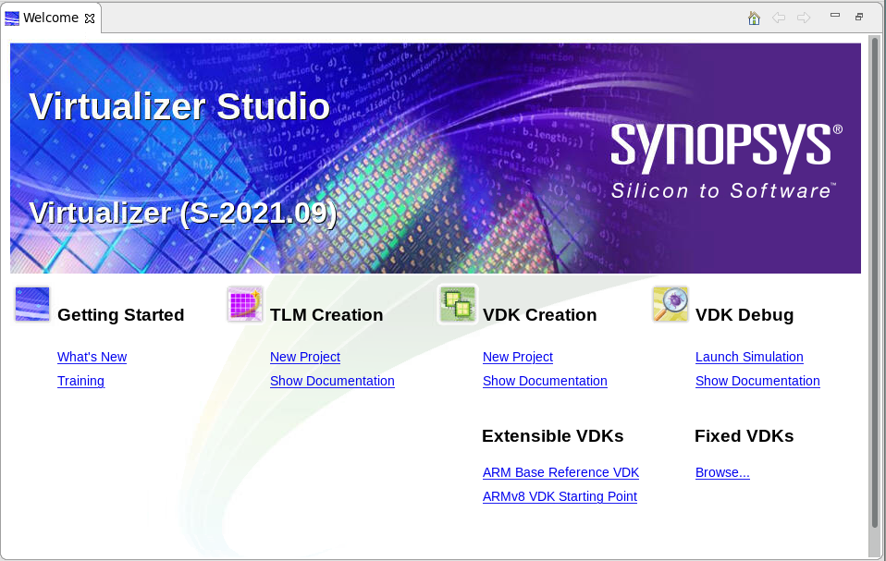
Virtualizer Studio – Overview
Powerful IDE for creating and using Virtual Prototype Development Kits (VDKs)
TLM Creation
Develop TLM Models
Debug & Unit Test Flow
System Integration Testing
VDK Debug
Debug a Virtual Prototype
Debug Embedded Software on the Virtual Prototype
Virtualizer
Studio
VDK Creation
Extend Reference VDKs
Create New custom VDKs
Extensible VDKs
ARM Base VDK
ARMv7 Starting Point VDK
ARMv8 Starting Point VDK
…
Notes:
Virtualizer Studio is an eclipse based-IDE, for creating and using Virtual Prototyping development Kits (or the VDKs).
TLM Creation, is the environment within Virtualizer Studio focused on the model creation. It helps you with developing a TLM component, adding the debug and testing flow and to go on to the system integration testing. Then, the VDK Creation Perspective, helps you with using and extending the referenced VDKs, for your software testing. You may also create custom virtual prototypes as per your design requirements.
Then, there is the VDK Debug perspective, which is fully equipped to help you debug your virtual prototype as well as the embedded software. Lastly, some easy starting points for you as the Referenced VDKs. Note that only the VDKs you have licensed will appear for use. Virtualizer studio as a whole provides you with an integrated environment, not only to Create and test design components but also to use them in Virtual prototypes creation and debugging.
Lets zoom in the TLM Creation perspective for now to understand the model creation flow.

Slide 9
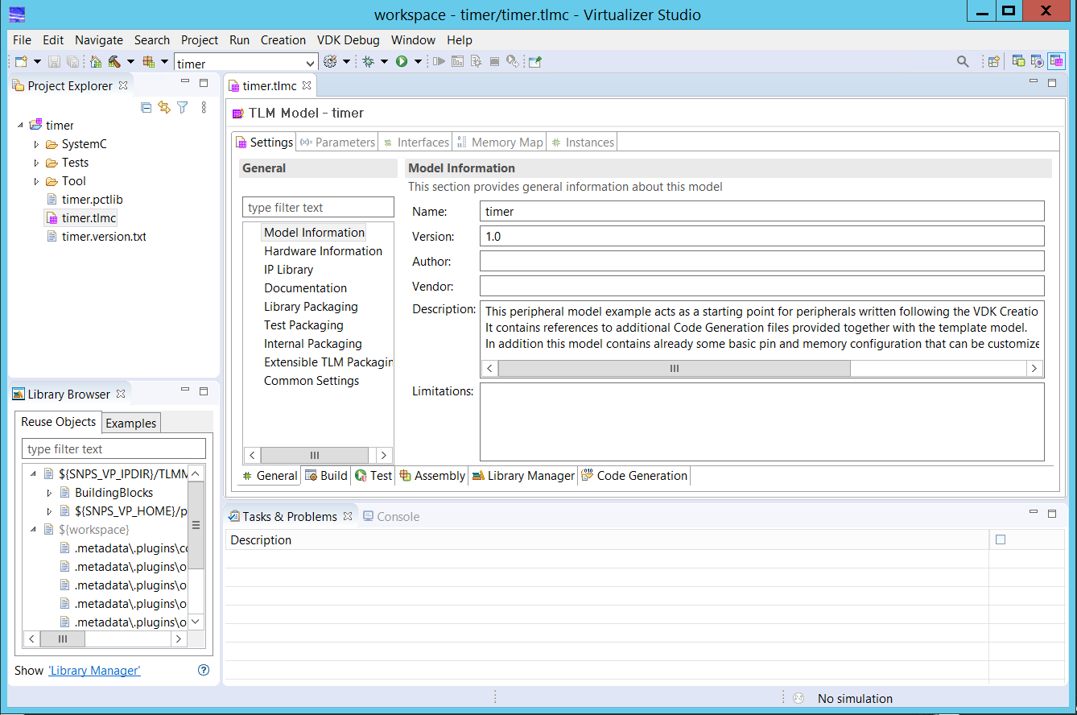
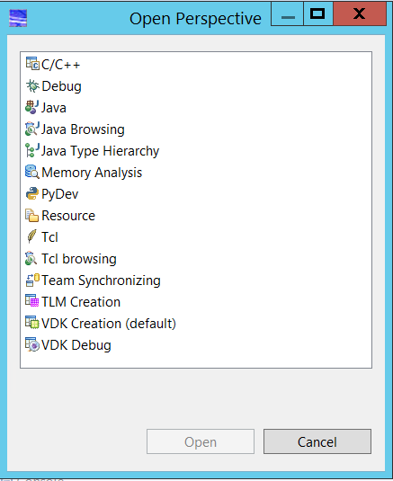
Virtualizer Studio – Perspectives Overview
Supported Perspectives
TLM Creation: TLM Model Creation
VDK Creation: VDK Assembly
VDK Debug : Virtual Prototype and
Embedded Software
Debugging
Debug : Model Debugging
Notes:
Virtualizer Studio provides different perspectives, catering to each user operation flow. The TLM Creation, for model creation, VDK creation, for VDK assembly, and VDK Debug, for Virtual Prototype and Embedded Software debugging.
You can easily switch between them, by simply clicking on the desired perspective tab, or using the Open Perspective button, that displays the Open Perspective dialog, where you can select any perspective and click Ok. The Common Development Environment facilitates easier development and debugging life cycle. The Common Development Environment facilitates easier development and debugging life cycle.

Slide 10
TLM Creation
TLM Creation Flow in Virtualizer Studio
Synopsys VDK Creation Methodology
Notes:
In this section, we will first learn about the model creation flow based on the Synopsys VDK Creation Methodology. Then, we will look at the TLM Model Creation flow in Virtualizer Studio.

Slide 11


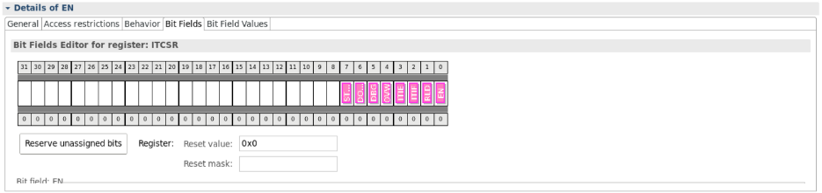

TLM Model Creation – Inputs & Outputs
Manual
entry
Component
Package
Component Library (XML)
Automated
Import
FastBuild
SC Lib
CSV
HTML
Documentation
Python/
Tcl
TLM Creation - Virtualizer Studio
Existing SystemC Model
Specifications
SystemC Model
TLM Model
Notes:
Virtualizer Studio supports the import of various data formats for the registers of the model, including IP-XACT, and Comma separated value or CSV formats. This allows to ease the synchronization of TLM modeling with other design tasks in the SoC design, for example RTL hardware design. Lets learn how, next.
The TLM creation technology of Virtualizer Studio enables you to convert the model specifications into a TLM implementation.
You can start by providing the design data details for your model such as its interfaces, registers, bit fields specifications, etc. using the Model Design Editor manually.
Or use an automated import from an IP-XACT or CSV input format. The Tcl scripting support provides further import customization options.
The built-in model generator processes the inputs and creates a desirable framework and Model source files with an empty or default implementations, and default unit tests.
You then simply need to modify or complete the source code for your model behavior and add more unit tests aimed at specific feature validations.
Virtualizer Studio provides you a powerful IDE to author, compile, and debug your model sources as well as create and run the associated component tests.
The output of TLM Creation in Virtualizer Studio, is a package that contains the component library specification, a FastBuild library for the TLM model, and related model documentation.
You can directly use your TLM model projects for the virtual prototype creation using the VDK Creation technology of Virtualizer Studio, or use the component library in Platform Creator as used in the older flow.

Slide 12

VDK Creation Methodology – TLM Model Creation
Test Driven Design (TDD)
ITERATIVE
Design Model
Create Test Plan
Add Behavior
Testing & Debugging
Export
  Study Specs
  Decide on the Model Architecture
  Interfaces, Storage, Parameters,
  Tracker Feature List
  Setup Component Tests
  For each feature in the spec, add a Component Test
  Implement Functional Behavior
  Add FastTrack logging
  Build & Run Component Test Suite
  Perform Model Source Code Debug
  Functional Coverage
  Author Model Documentation
  Build & Package Model
  Generate Component Library (XML Representation)
Notes:
Synopsys VDK Creation Methodology provides a proven methodology for creating both TLM models, and VDKs.
The TLM Model creation flow starts with the model specification. You need to review the requirement specs, to decide on the model architecture by selecting the model interfaces, internal MemoryMap and register specification, parameters to be used, and so on. As an outcome of this step, you would also be creating a Tracker Feature List, listing all the required features of the model.
Following a test driven design approach or TDD, you will first need to create a test plan and unit tests for a logical chunk of features from the tracker as desired and then, add the required functional behavior code in the source files. You should be adding the associated documentation, and Virtualizer FastTrack logging to your functional C++ code, for better debugging support later when the model is used.
Once behavior is added, the component test suite needs to be built and run on the model implementation, so as to ensure functional correctness. To analyze the test results, you can also make use of the integrated source code debugging support.
All steps from model design to testing, and debugging need to be executed iteratively, till all the model features are implemented and tested.
Next, you come to the last step to generate and package the model implementation for exporting. You should enhance the generated documentation, and create Model Component Library, for final packaging.
The TLM Creation technology of Virtualizer Studio, supports this flow and provides a complete model creation solution. Next, lets see how it works.

Slide 13
VDK Creation Methodology – TLM Model Creation
Test Driven Design (TDD)
Recommended steps for developing TLM models under this approach are as follows.
Break down the development cycle into smaller chunks of coding and testing.
Start development with writing tests and add the functionality later.
Use an iterative approach to check your model functionality using the following steps:
  Modify: add or modify one logical chunk of functionality to your model and tests.
  Build: export/save your changes, if needed, and build them.
  Run: run the unit test with logging enabled.
  Check Results: check the test results about failed assertions or tests that did not complete. Check the functional coverage reports to determine to what extent the tests actually cover the desired features. Analyze the reasons by looking at the logs and reviewing or debugging the source code.
Notes:
Synopsys VDK Creation Methodology provides a proven methodology for creating both TLM models, and VDKs.
The TLM Model creation flow starts with the model specification. You need to review the requirement specs, to decide on the model architecture by selecting the model interfaces, internal MemoryMap and register specification, parameters to be used, and so on. As an outcome of this step, you would also be creating a Tracker Feature List, listing all the required features of the model.
Following a test driven design approach or TDD, you will first need to create a test plan and unit tests for a logical chunk of features from the tracker as desired and then, add the required functional behavior code in the source files. You should be adding the associated documentation, and Virtualizer FastTrack logging to your functional C++ code, for better debugging support later when the model is used.
Once behavior is added, the component test suite needs to be built and run on the model implementation, so as to ensure functional correctness. To analyze the test results, you can also make use of the integrated source code debugging support.
All steps from model design to testing, and debugging need to be executed iteratively, till all the model features are implemented and tested.
Next, you come to the last step to generate and package the model implementation for exporting. You should enhance the generated documentation, and create Model Component Library, for final packaging.
The TLM Creation technology of Virtualizer Studio, supports this flow and provides a complete model creation solution. Next, lets see how it works.

Slide 14

Next Steps
1 | Introduction
2 | Part 1: Creating the Model Skeleton
3 | Part 2: Test Driven Design Methodology
4 | Part 3: Model Behavior Implementation
5 | Part 4: Model Debugging
6 | Part 5: Import of Existing SystemC Models
7 | Hands-on Labs Modules
Notes:
Go over the other modules of the training module to learn more about the TLM Creation perspective of Virtualizer Studio.

Slide 15
Training Labs Overview
Modular training labs - different modules with different examples and level of depth:
Module 1: Programmable Interval Timer Example
  Relatively simple, but real-life modeling example (from NXP M-Core HW spec)
  Model creation in TLM Creator, with optional imported register definitions e.g. through IP-XACT
  Suited for shorter customer trainings, or showing a broader range of aspects with less detail depth
  All major modeling flow steps covered in different labs with a starting point project for each
    Sequence of labs builds a story-line, but you may skip labs as required for your customer
Module 2: Serial Peripheral Interface (SPI) Controller Example
  More complex model example for model creation in TLM Creator
  Requires more time, but teaches aspects like reuse objects in more detail
  Suited for more experienced or dedicated modeling teams
Module 3: SystemC import flow
  Describes the flow to import existing SystemC models into TLM Creator for further usage in VDKs
For more details, refer to the TLMC Labs Overview document
Notes:
Accompanied Lab Modules Overview

Slide 16
References and Further Reading …
Customer Training Modules
  Introduction to the SystemC and SCML
  VDK Creation Quickstart Training
  VDK Debug Quickstart Training
  SCML2 Fast-Timed Modeling Training
Virtual Prototyping Documentation
  VDK Creation Methodology Manual
  TLM Creator User Guide
  VDK Creator User Guide
  SystemC Modeling Library Reference Manual

Slide 17

Thank You

